Slide 1
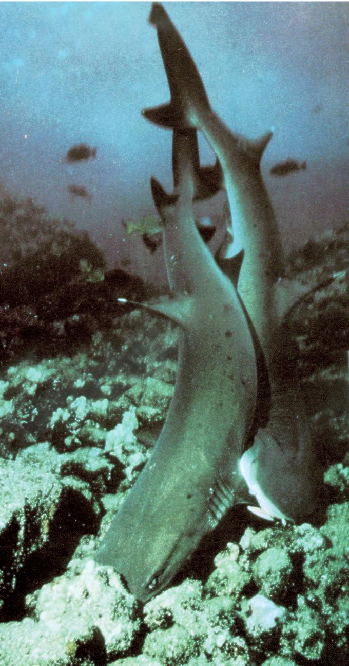
Next generation
軟骨魚類--
1、鯊魚
2、鮫
3、魟

Slide 2
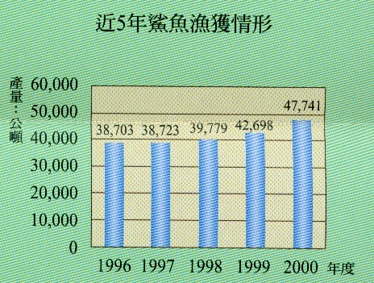

Slide 3
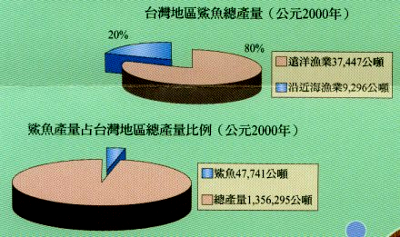

Slide 4
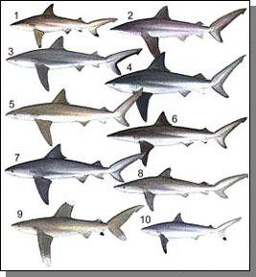
具攻擊性之鯊魚
BLACKTIP SHARK
(黑鰭鯊)
2. BIGNOSE SHARK
(大鼻鯊)
3. GREY REEF SHARK
(灰礁鯊)
4. PIG EYE SHARK
(豬眼鯊)
5. BRONZE SHARK
(古銅鯊)
6. LONE NOSED GREY SHARK
(長鼻鯊)
7. BULL SHARK
(公牛鯊)
8. SILKY SHARK
(絲鯊)
9. OCEANIC WHITETIP
(遠洋白鰭鯊)
10. SPOT-TAIL SHARK
(尾點鯊)

Slide 5
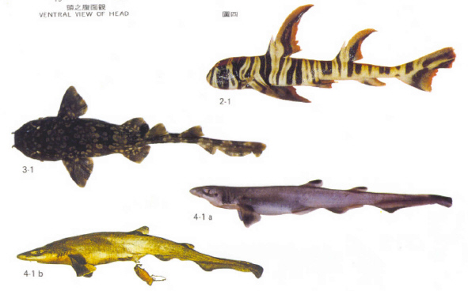
其他鯊魚

Slide 6
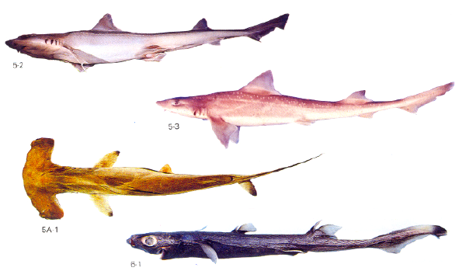

Slide 7
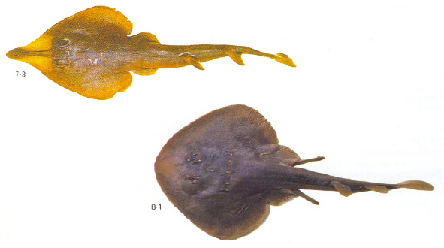

Slide 8
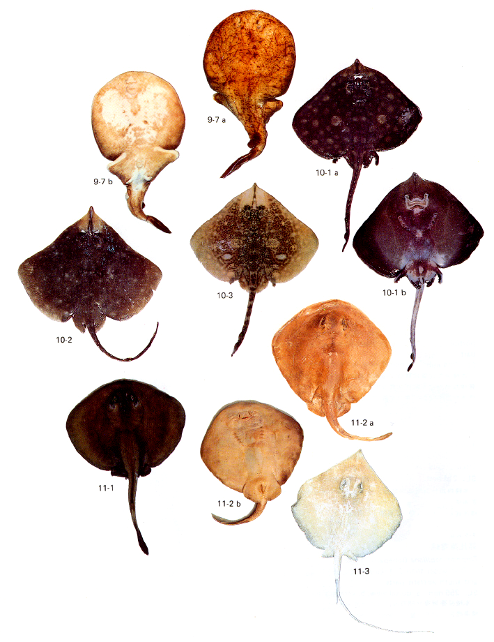


Slide 9
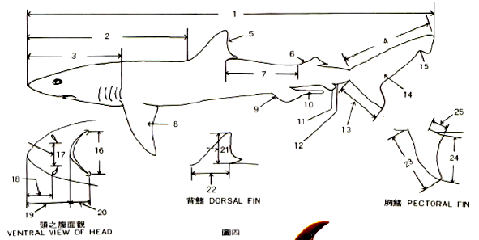
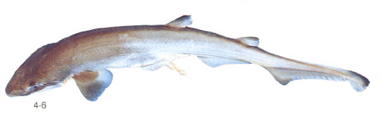

Slide 10
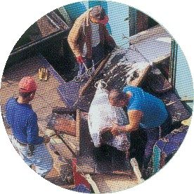
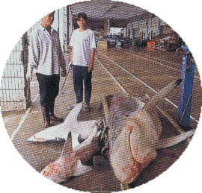
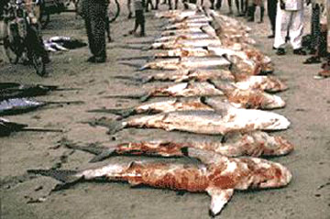

Slide 11
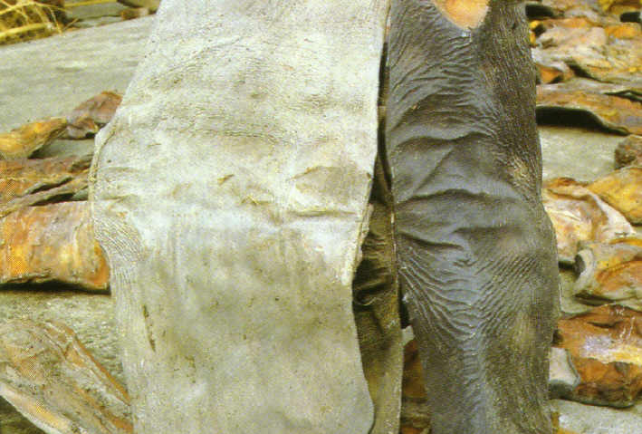
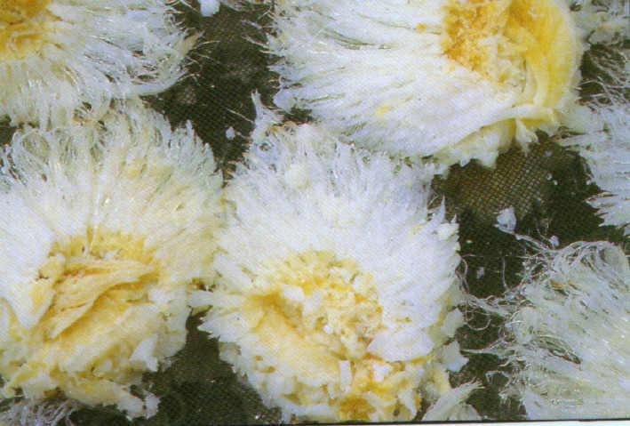
魚皮乾製品
魚鰭煮乾品

